Slide 1
Disasters and Linear Infrastructure Management
by
Stephanie Amoaning-Yankson
Dr. Adjo Amekudzi
Georgia Institute of Technology
University Transportation Center (UTC) Conference
for the Southeastern Region
4th - 5th April, 2013
Rosen Plaza Hotel Orlando, Fla.

Slide 2
Overview
Motivation for research
Overview of some major disasters
Disaster impacts on transportation infrastructure
Resiliency in transportation
Future work
Notes:
Problems caused by disasters
Why we need to protect them: criticality of transport infrastructure
How: by building resilience into our transport infrastructure

Slide 3
Motivation: Criticality of Infrastructure
The Patriot Act defines critical infrastructure as
“systems and assets, whether physical or virtual, so vital to the United States that the incapacity or destruction of such systems would have a debilitating impact on security, national economic security, national public health or safety, or any combination of those matters”
- (P.L. 107-56, Sec. 1016(e), 2001)
The transportation system is one of the nation’s sixteen defined critical infrastructure sectors.

Slide 4
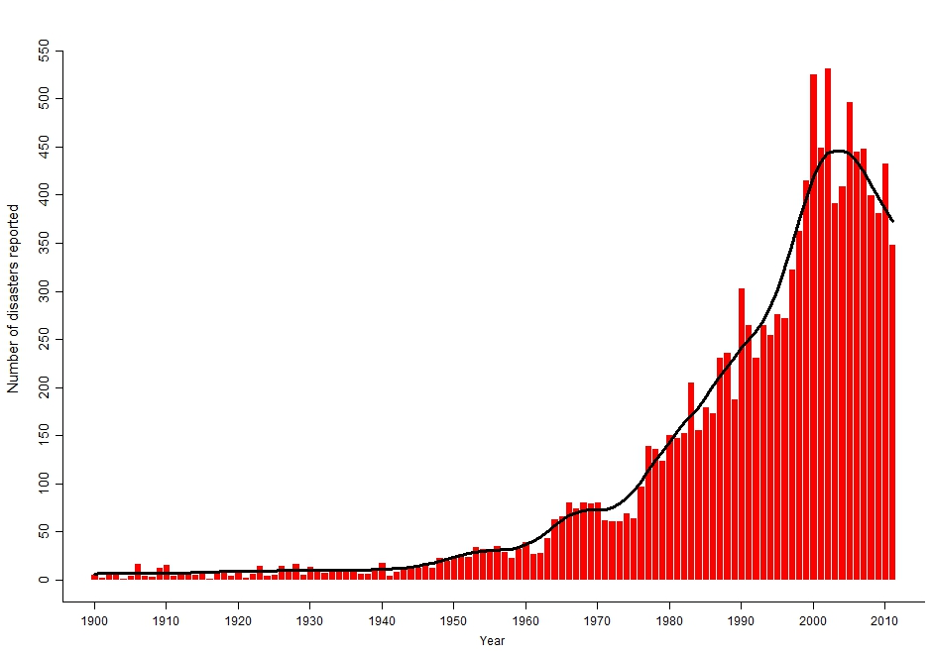
Motivation: Threat of Natural Disasters
Fig 1: Natural Disasters reported worldwide between 1900 and 2010
Source: EM-DAT: the International Disaster Database-www.emdat.be-Universite Catholique de Louvain, Brussels-Belgium
Notes:
Minimum of 10 fatalities
100 people affected
Call for international assistance
State of emergency declared

Slide 5
Motivation: Impact on National Economy
The table below shows the most destructive U.S. natural disasters in the last 30 years.
Date | Disaster | Damage (billion US$)
8/29/2005 | Hurricane Katrina | 125
10/28/2012 | Hurricane Sandy | 50
1/17/1994 | Northridge Earthquake | 30
9/12/2008 | Hurricane Ike | 30
8/24/1992 | Hurricane Andrew | 26.5
9/15/2004 | Hurricane Ivan | 18
9/23/2005 | Hurricane Rita | 16
8/13/2004 | Hurricane Charley | 16
10/24/2005 | Hurricane Wilma | 14.3
 | Total | 350.8
Table 1: Top nine natural disasters in the United States sorted by economic damage costs (1984-2013)
Source: "EM-DAT: The OFDA/CRED International Disaster Databasewww.em-dat.net - Université Catholique de Louvain - Brussels - Belgium"

Slide 6
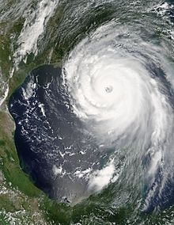
Hurricane Katrina (August 29th, 2005)
Category 3 hurricane
Wind strength of up to 125mph
Minimum pressure of 920mb
Storm surge of up to 30ft
1833 fatalities
Extensive damage was due to storm surge and levee breaches and resulting flooding
$125 billion (normalized 2007 dollars) in damages
Hurricane Katrina at peak strength on August 28, 2005.
Source: en.wikipedia.org
Notes:
Three landfalls 1)cat 1-florida, 2) cat. 4 (140mph)- Plaquemines Parish, Louisiana, & 3) cat. 3- Deadliest hurricane since the 1928 Okochebee (4,000+ fatalities) This storm in itself was not the storm of the century. By contrast, 1969’s Hurricane Camille was a category 5 with wind speeds greater than 155 mph.

Slide 7
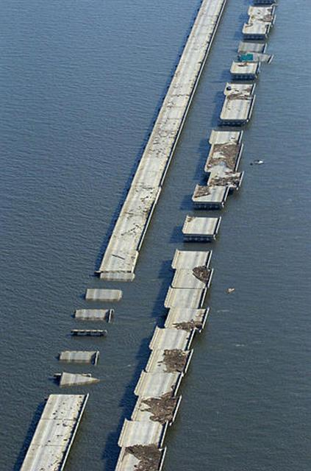
Hurricane Katrina: Infrastructure Impacts
Bridges:
45 bridges sustained damage in:
Alabama
Mississippi
Louisiana
Vital damaged bridges were:
I-10 Twin Span Bridge
Pontchartrain Causeway
St. Louis Bay Bridge
Biloxi Bridge
Damaged I-10 Twin Span Bridged

Slide 8
Infrastructure Impacts: Bridges
Cause of Damage | Type of Damage | Nature of Repair/Renewal | Cost of Repair/ Renewal
Lifting & pounding of water, leading to breakages in connection between pilings and piers Loose barges and boats | Superstructure damage consisted of unseated decks and damaged guardrails with little damage to substructure | Elevated bridges (6 meters higher than former bridge) to reduce probability of storm surge damage Twin Span Bridge equipped with monitoring system Vertical constraint devices and air vents proposed to be effective in limiting damage | Estimated $1 billion in overall repair/ replacement cost, including emergency repairs and rebuilding
Notes:
Most damaged bridges were adjacent to water
Monitoring system includes sensors to detect when infrastructure is hit by anything
There’s also a weigh in motion scale to measure the weight of trucks traveling over the bridge.

Slide 9
Infrastructure Impacts: Roads & Rail
Infrastructure | Causes/Type of Damage | Nature of Repair/Renewal
Roads | Significant debris Submerged roads Sections of roads torn apart e.g.: La 23 in South Louisiana | Utilities, sidewalks, American with Disabilities Act compliant ramps, driveway aprons, curbs and road paving Estimated $200 million for debris removal
Rail | Broken anchor bolts & damaged angle clips Debris carried by storm | Switch from anchor bolts to through rods on connections to precast I-girders on new construction Corrosion protection by coating re-bars and using high performance concrete

Slide 10
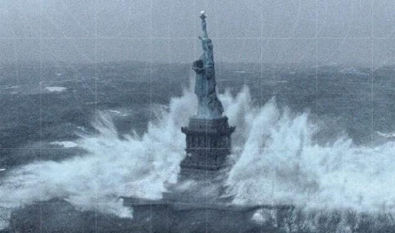
Hurricane Sandy (October 29th, 2012)
Category 1 hurricane, weakened to a post-tropical cyclone
Southeast, mid-Atlantic, New England, Appalachia & Mid-West
Maximum winds of 115mph
Minimum pressure of 940mb
147 fatalities
Storm surge of 14 feet
Damage in U.S estimated over $50 billion
Picture of the Statue of Liberty taken during the storm
Source: www.designbuildsource.com.au
Notes:
Although only a category 1 hurricane, sandy had a high a integrated kinetic energy, meaning it was bigger than katrina. Also the new york/jersey area is more dense.

Slide 11
Hurricane Sandy: Infrastructure Impacts
Infrastructure | Causes/Type of Damage | Nature of Repair/Renewal
Roads/Bridges | Two out of 28 bridges warranted emergency repairs Embankment washouts Tilted light poles Downed traffic signals Excessive debris | Debris removal Traffic signal & light pole repairs/replacements
Subways & Tunnels (Southferry subway, battery tunnel, Belle Harbor, Battery Park Underpass) | All seven tunnels under East River flooded Two Long Island Rail Road Tubes flooded Two vehicular tunnel inundated One subway bridge flooded Three subway yards flooded Six bus facilities flooded | Inspecting, cleaning and repairing of electrical components
Wastewater (Five of NYC‘s wastewater treatment plants located in lowest-lying areas of the city) | Mixture of sewage and storm water bypassing plant flowing directly into New York’s waterways and into the flooded streets and buildings

Slide 12
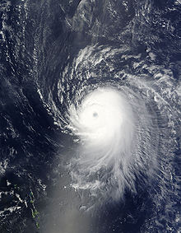
Hurricane Ike (September 5th, 2008)
Category 2 hurricane at landfall
Fifth hurricane of the 2008 Atlantic hurricane Season
Maximum winds of 145 mph
Minimum pressure of 935 mb
195 fatalities
Damages of $30 billion in the U.S
Hurricane Ike at peak intensity
Source: en.wikipedia.org

Slide 13
Hurricane Ike: Infrastructure Impacts(1)
Infrastructure | Causes/Type of Damage | Nature of Repair/Renewal
Roads | Generally washouts to roadbeds and shoulders 90% of signals in Houston were damaged or lost power Damage to several traffic signs 5mile section of the State Highway 87 in Texas was washed away | Emergency contracts issued to repair advance flashers and traffic detection systems
Bridges | Decking of the State Highway 82 Causeway Bridge swing bridge was moved about 6 inches by storm surge | A 65-ft replacement elevated bridge built

Slide 14
Hurricane Ike: Infrastructure Impacts(2)
Infrastructure | Causes/Type of Damage | Nature of Repair/Renewal
Rail | Debris deposited on tracks Decks and caps floated off trestles Tracks washed off embankments and bridges but not in areas where they secured to piles 1.6 km of Union Pacific track shifted off road bed Railroad buildings were subject to wind damage Repairs to 21 miles of track damaged by Hurricane Gustav in New Orleans were washed away | Service was generally restored on affected lines within two days and after a week on less important lines
Canals/Ports | Erosion damage to Galveston Seawall Galveston/Bolivar Ferry operations heavily damaged Salt water intrusion caused extensive damage to hydraulic systems | $25 million allocation for the rehabilitation of the seawall by the U.S Army Corps of Engineers

Slide 15
How do we protect our infrastructure?

Slide 16
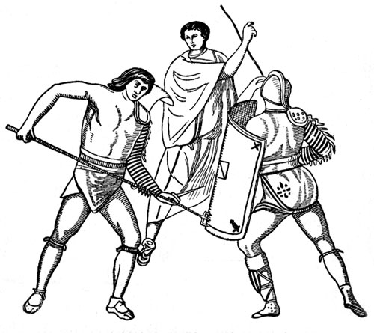
Resistance vs Resilience
Resilience has in recent years replaced the concept of resistance in disaster research
Resistance emphasizes the importance of predisaster mitigation measures that enhance the performance of structures, infrastructure elements, and institutions in reducing losses
Resilience reflects the concern for improving the capacity of physical and human systems to respond to and recover form extreme events
Source: www.karenswhimsy.com
Notes:
Harold Foster analogy of resistance vs resistance

Slide 17
Resilience Concepts
Definitions:
“The ability of a system to reduce the chance of a shock, to absorb a shock if it occurs and to recover quickly after a shock.” -(Bruneau et al. 2003)
“The ability to accommodate change gracefully without any catastrophic failure”
- (Foster, 1997)
Transportation resiliency can be defined as “the ability for the system to maintain its demonstrated level of service or to restore itself to that level of service in specified timeframe” (Heaslip et al., 2009).
More specifically, a resilient system is one that shows:
-Reduced probability of failure
-Reduced consequences from failures (damage, fatalities, negative economic & social consequences)
-Reduced time to recovery
Notes:
Resilience has been used in several disciplines
enterprises disaster research
economics transportation engineering
Water resource management
Social study

Slide 18
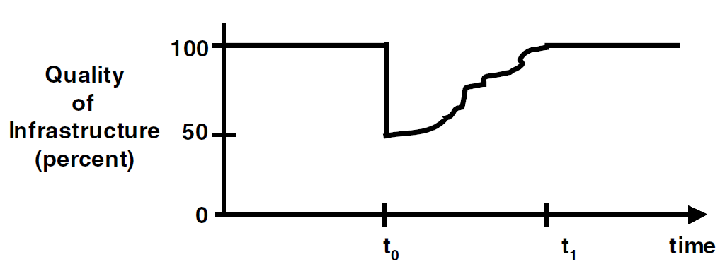
Resilience Concepts
A system’s resilience may be measured by:
The functionality of the system after a disruption
The time it takes to return to pre-disruption levels
Fig 2: Resilience triangle showing 50% loss in infrastructure functionality
Source: Tierney, K. and Bruneau, M. “Conceptualizing Resilience”. TR News 250 May-June, 2007
Notes:
Depth shows severity of damage
Length shows time to recovery
The smaller the triangle, the more resilient the system

Slide 19
Future Work
Define a set of metrics that can be used to assess resilience in state DOTs
Incorporate these metrics into a framework that can be used in the transportation planning process

Slide 20
References
“Assessing the Damage from Hurricane Sandy”. The New York Times, N.Y/ Region, October 29, 2012. Retrieved on November 9th, 2012. http://www.nytimes.com/interactive/2012/10/30/nyregion/hurricane-sandys-aftermath.html
“Christie Administration Responds to NJ Transit Infrastructure Damage Following hurricane Sandy”. State of New Jersey. October 30th, 2012 http://www.nj.gov/governor/news/news/552012/approved/20121030e.html
Conan R. “ Hurricane Sandy Leaves at Least 21 Dead, Heavy Infrastructure Damage-Carribean” Business News Americas, Water and Waste. October 29th, 2012.
“Critical Foundations, Protecting America’s Infrastructures”. The Report of the President’s Commission on Critical Infrastructure Protection. October 1997.
DesRoches, R. and Glenn, R. “Hurricane Katrina’s Impact on Louisiana’s Transportation Infrastructure”. School of Civil and Environmental Engineering, Georgia Institute of Technology.
“DOT Activities in support of Federal Response to Hurricane Katrina”. The Disaster Center’s Tropical Storm-hurricane Katrina Page, September 5th, 2005.
Miller, R. “Hurricane Katrina: Communications & Infrastructure Impacts”. National Defense University
Information compiled from the National Oceanic and Atmospheric Administration’s (NOAA’s) Tropical Prediction Center (www.nhc.noaa.gov), FEMA news releases, and press reports.
Tierney, K. and Bruneau, M. “Conceptualizing Resilience”. TR News 250 May-June, 2007. Transportation research Board of the National Academies.

Slide 21
Questions?
Contact information
Stephanie Amoaning-Yankson
sayankson@gatech.edu
Georgia Institute of Technology
Sustainable Education Building
Room# 319

