Slide 1





Traffic Safety Impacts of Digital Roadside Advertising in Alabama and Florida
Virginia Sisiopiku, UAB
K. Haleem, M. Islam, A. Gan, P. Alluri, A. Sullivan, D. Stavrinos
2nd Annual UTC Conference for the Southeastern Region, Atlanta, GA, March 25, 2014

Slide 2
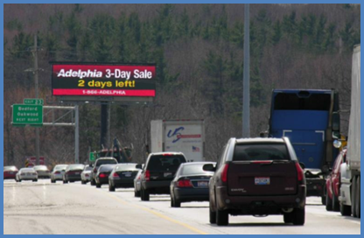
RESEARCH SCOPE
Investigate links between Digital Advertising Billboards-Distraction-Traffic Safety Risk
Multi-state and multi-facet approach
  State-of-Practice-Synthesis
  Survey of Road Users
  Driving Simulator Study
  Epidemiological Study
Notes:
There is an ongoing debate on whether or not the presence of digital billboards really distracts driver’s attention
Conservative estimates put external distractions responsible for up to 10% of all traffic incidents
Klauer et al. report that 23% of crashes and near-crashes that occur in metropolitan environments are attributable to eyes off the forward roadway greater than two seconds.

Slide 3
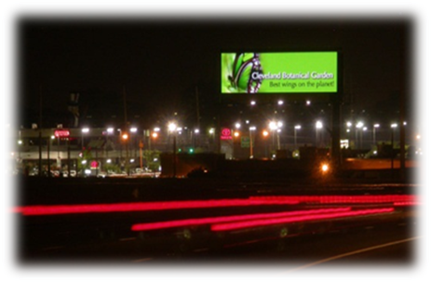
DIGITAL BILLBOARDS UNIQUE FEATURES
Brightness and contrast with surroundings
Messages changing suddenly
Realistic imagery
No acclimation with message
Potential for message sequencing
Potential for interactivity with driver
Notes:
Utilize light-emitting diode (LED) technology to provide vivid displays that can be updated every few seconds using computer input.
Fast growing market
4,000 + in US
Advantages:
single board can advertise to far more clients than a traditional board
clients can update their advertisements frequently, and
targeted messaging

Slide 4
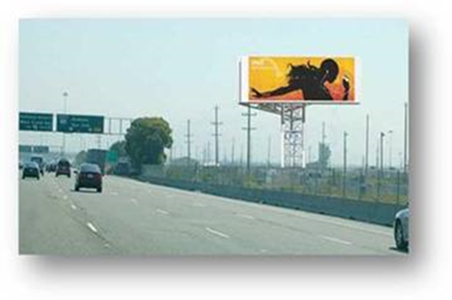
1. STATE-oF-PRACTICE SYNTHESIS
Approach
Meta-analysis studies
Crash studies of historical trends
Laboratory studies
Naturalistic studies of driving behavior
Notes:
Since the passing of the Highway Beautification Act (HBA) in 1965, federal, regional, and local authorities have attempted to control outdoor advertising through the introduction of standards and restrictions on size, placement, content, and durability. Naturally, as new technologies emerge in the outdoor advertising industry, authorities must develop new restraints to maintain safe and sustainable industry practice.

Slide 5
STATE-oF-PRACTICE SYNTHESIS
Findings
Overall, the state-of-practice synthesis suggests that there is evidence of correlation between digital advertising billboards and increased driver distraction.
However, local conditions, experimental settings, and other factors may play a role in the actual impact that digital advertising billboards have on traffic safety

Slide 6
2. Survey of road users approach
Goal: Survey of driver’s perceptions and attitudes toward digital advertising billboards
  Demographics/Exposure
  Perceived safety and efficiency
  Regulations
Method:
  Online
Response:
  295 AL; 340 FL

Slide 7
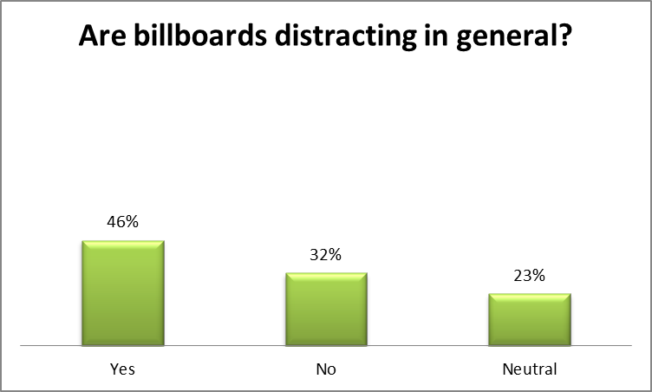
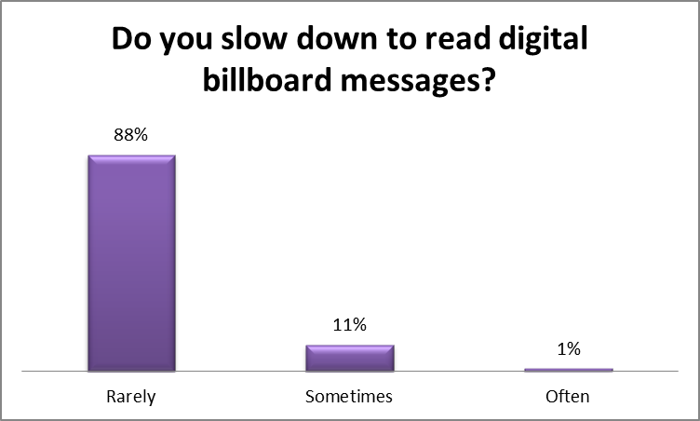
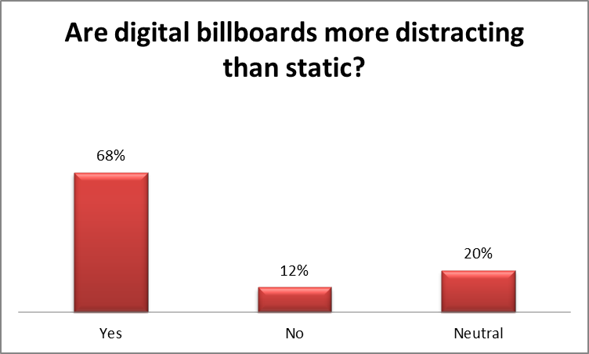
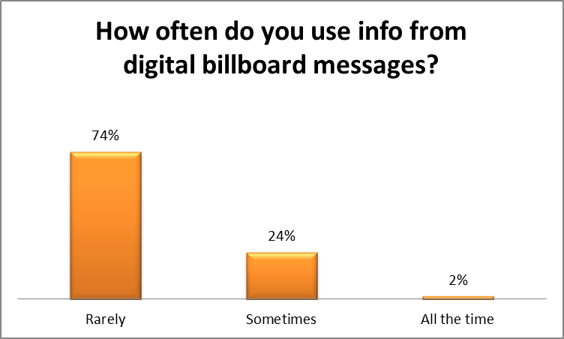
Survey of road users
Sample Findings- Alabama Drivers

Slide 8
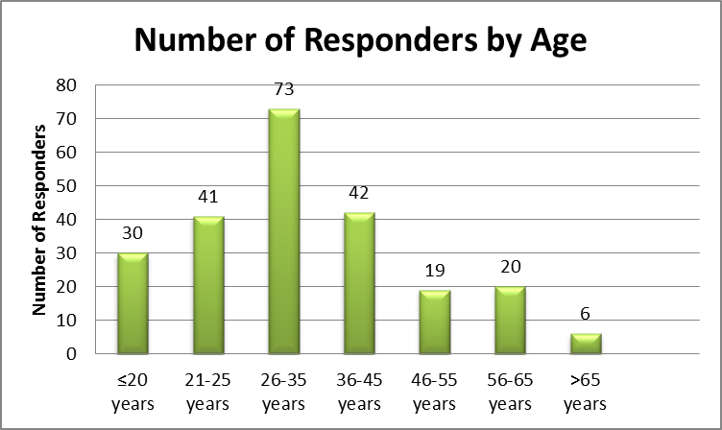
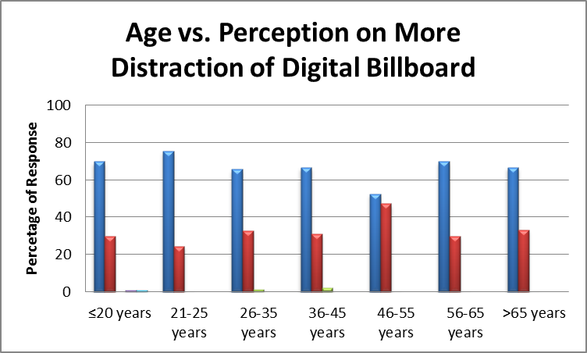
Survey of road users sample Findings- Alabama Drivers
Notes:
younger driver group actually perceived the distraction caused by billboards and also the higher distraction level when the billboards are digitized.

Slide 9
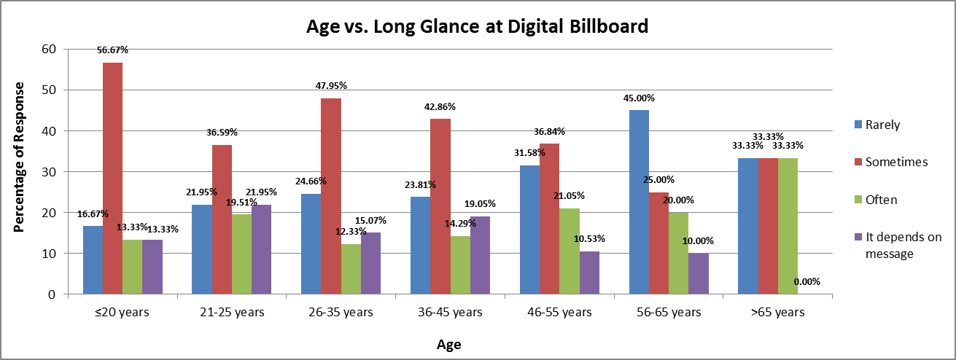
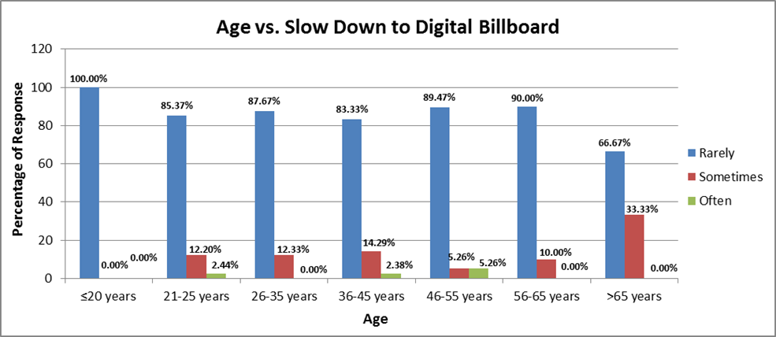
Survey of road users
Sample Findings- Alabama Drivers
Notes:
It has also been revealed that young drivers usually have a long glance at digital billboards but very rarely slow down.

Slide 10
Survey of Road users
Findings Summary- Alabama Drivers
Road users perceive digital billboards as more dangerous than static
Younger drivers admit staring at digital billboards longer without adjusting their speeds
Responders overwhelmingly agree on the need for stricter regulations of billboards

Slide 11
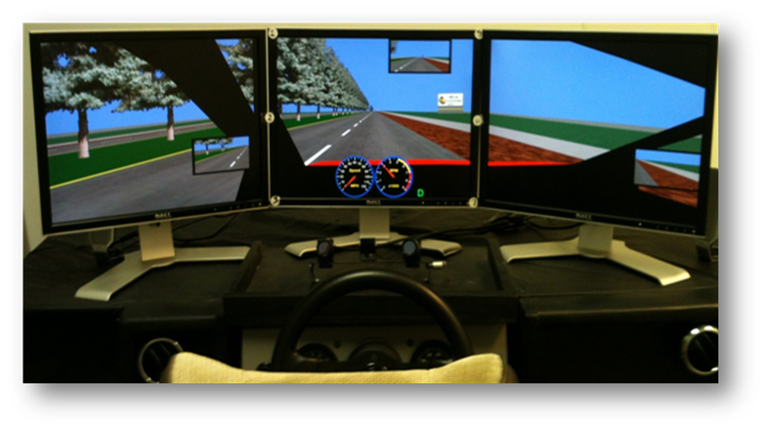
3. Driving Simulation Study
Approach
  Goal: Evaluate the distractive effects of roadside billboards through the use of the UAB driving simulator
  Approach:
    Developed driving simulator data collection protocol
    Developed driving simulator scenarios
      16 mile simulated highway driving scenario, with a mixture of digital and static billboards
    Recruit participants (57)
    Data collection and analysis
Notes:
250 and 500-foot billboard transition DBB; static; no

Slide 12
Driving Simulation Study
Analysis
Length of Eye Gaze
    Percent of time participants spent looking at billboards while driving
Memory Recall and Recognition
    Post-drive memory recall of information presented on billboards.
Driving Performance
    a) the number of speed limit exceedances, v>69 (mph)
    b) the number of road edge excursions, and
    c) the total number of motor vehicle collisions

Slide 13
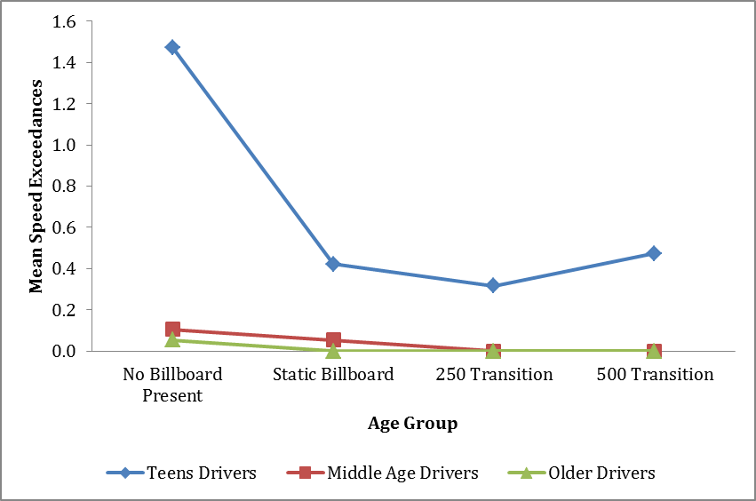
Driving Simulation Study
Sample Findings
Participants had fewer speed exceedances when there was a billboard present
Teens, as expected, had more speed exceedances than middle aged and older drivers

Slide 14
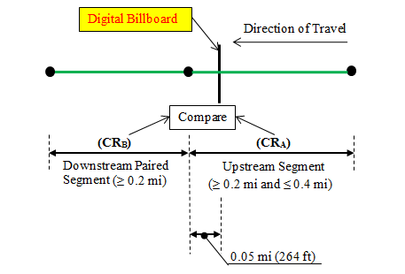

3. Crash analysis approach
Goal: Analysis of historical crash records in the vicinity of digital billboards
Approach:
  Identification of sites
    AL: I-65; I-20/59, I-459; I-565; I-85; I-10
    FL: SR 826, SR 408, and SR 528. I-95, I-395, and I-4
  Methodology
  Crash data analysis

Slide 15
4. Crash analysis
Sample Findings – Florida Sites
Crash Summary Statistics at the FL Digital Billboard Locations
Mixed results
Overall, crash rates nearly 25% higher in the area of digital billboard influence (upstream)

Slide 16
Crash analysis
Sample Findings – Florida Sites
Summary Statistics at the FL Digital Billboard Locations by Crash Type
Higher crash rates were observed for collisions with fixed objects and sideswipe in the area of digital billboard influence (upstream)

Slide 17
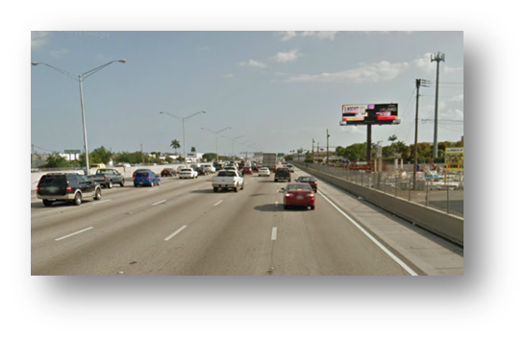
Study Contributions
Provides an objective multi-dimensional evaluation of the impact of digital billboards on safety
Raise awareness of safety issues related to digital billboard advertising
Update guidelines for regulation and placement of digital advertising billboards at the regional and national levels

Slide 18
QUESTIONS AND COMMENTS

