Slide 1
Prototype Evidence-based Database for Transportation Asset Management
Janille Smith-Colin, Infrastructure Research Group
2014 UTC Conference for the Southeastern Region
March 25th, 2014

Slide 2
References
Amekudzi Kennedy, A., et al. Evidence-based Decision Making: Developing a Knowledge Base for Successful Program Outcomes in Transportation Asset Management - Final Report. March 2014. Submitted to Georgia Department of Transportation.
Smith-Colin, J., Fischer, J., Akofio-Sowah, M., and Amekudzi Kennedy, A. Evidence-Based Decision Making for Transportation Asset Management: Enhancing the Practice with Quality Evidence and Systematic Documentation. August 2013 (TRR publication forthcoming).

Slide 3
Agenda
Fundamental concepts
Transportation Asset Management (TAM)
Evidence-based approaches (EB approaches)
Background - Applications of the EB approach
Other fields
Transportation
Research objectives and methodology
TAM Evidence Exchange
PICMO - evidence-based framework for TAM
Prototype evidence-based database

Slide 4
Fundamental Concepts
What is TAM?
A strategic and systematic process of operating, maintaining, upgrading and expanding physical assets
What is an evidence-based approach?
Uses evidence of success/failure from past experience to influence future practice
Best available evidence
Accumulated/documented evidence
Practitioner input
Rigorous “scientific” testing
Systematic methods
Quantified using the AASHTO TAM Maturity scale
Throughout their lifecycle
Notes:
Initial – Often a lack of motivation to improve
Awakening – There is often a reliance on the heroic efforts of one individual
Structured – Development of processes and tools

Slide 5
Applications of the Evidence-based Approach
Healthcare, education, business management, social policy
Evidence-based design (EBD)
Evidence-based policy
Evidence-based planning
Evidence-based management
Evidence-based decision making (EBDM)
Notes:
Healthcare (Designing “healing environments”); social policy; education; organizational management

Slide 6
Evidence-Based Approaches in Transportation
Evidence-based research dating back to 1999 (TRID)
Approximately 50 studies found
Studies lack systematic methods or rigorous testing
Transportation Area | Sample Studies
Road/Traffic Safety | 18
Injury Prevention | 9
Policy | 8
Other* | 6
Occupational Therapy | 3
Asset Management/ Performance | 1
Notes:
TRID = Transportation Research Board Database
Other = Examples of “other” categories: health effects, freight movement, and multimodal transportation

Slide 7
Research Objectives
Develop a framework for evidence-based transportation asset management
Allow for the use of best available evidence in TAM decision making
Link evidence to the TAM maturity
Build a database of evidence for TAM decision making and knowledge transfer
Evidence-based
decision making
Transportation asset management
Evidence-based asset management (EB-TAM)

Slide 8
Methodology
Literature Review
evidence-based approaches in other fields
Literature Review
evidence-based approaches in transportation
TAM Evidence Exchange
practitioner input/ data collection
Asset management case study review and synthesis
EB-TAM
PICMO documentation framework development
EB-TAM
prototype database development
Development of structure and content of database

Slide 9
TAM Evidence Exchange
Themes | Key Observations
System Integration | An integrated system considers the maintenance tradeoffs that occur when the decision is taken to maintain one set of assets over another. Oregon DOT adopted an integrated systems approach.
Data Collection | Practitioners are less interested in directives that promote collecting additional data. The current challenge is how to support good decision-making
Evidence Quality and Value | Documentation is key to demonstrating the value of evidence. For example asset managers can make a case for a program structure change based on documented evidence of improved outcomed
Knowledge Transfer | Other useful methodologies for generating evidence include the business case analysis, and pilot studies. Emphasis needs to be placed on developing the evaluation and feedback stages (feedback loop) of the program and project development process. It is at this point that true connections can be made between investments/interventions and outcomes
Risk Management | What is the business risk across all assets? Can acceptable risk be documented as agency policy?
Investment Tradeoffs | Tradeoff analysis can produce new evidence in support of decisions made.
Themes | Key Observations
System Integration | An integrated system considers the maintenance tradeoffs that occur when the decision is taken to maintain one set of assets over another. Oregon DOT adopted an integrated systems approach.
Data Collection | Practitioners are less interested in directives that promote collecting additional data. The current challenge is how to support good decision-making
Evidence Quality and Value | Documentation is key to demonstrating the value of evidence. For example asset managers can make a case for a program structure change based on documented evidence of improved outcomes

Slide 10
PICMO – Evidence Framework
Framework | Assessment Questions | Sample Application
P Problem | What problem was solved?; What asset was impacted? | No clear understanding of agency ability to implement TAM
I Intervention | What intervention was used to address the problem? | Complete inventory of roadway segments to identify needs and gaps
C Context | What is the motivation for solving the problem ?; particular relationships, institutional settings impacting the outcome? | Agency desire to strategically manage assets given limited funding and comprehensive data
M Mechanisms | What is the pathway through which impacts are observed?; rigorous testing method used? | 2-year pilot study
O Outcomes | What are the (intended or unintended) effects of the intervention?; How can effects be quantified? | Restructured TAM program development; asset condition improvement over six years
Framework | Assessment Questions
P Problem | What problem was solved? What asset was impacted?
I Intervention | What intervention was used to address the problem?
C Context | What is the motivation for solving the problem ? What particular relationships, or institutional settings had an impact on the outcome?
M Mechanisms | What is the pathway through which impacts are observed? What testing method was used to evaluate the outcome?
O Outcomes | What are the effects of the intervention? How are effects quantified?
Framework
P Problem
I Intervention
C Context
M Mechanisms
O Outcomes
Notes:
Building on the work highlighted by Briner (17) in evidence-based management, the research team has developed a hybrid framework (derived from PICO and CIMO) called PICMO.

Slide 11
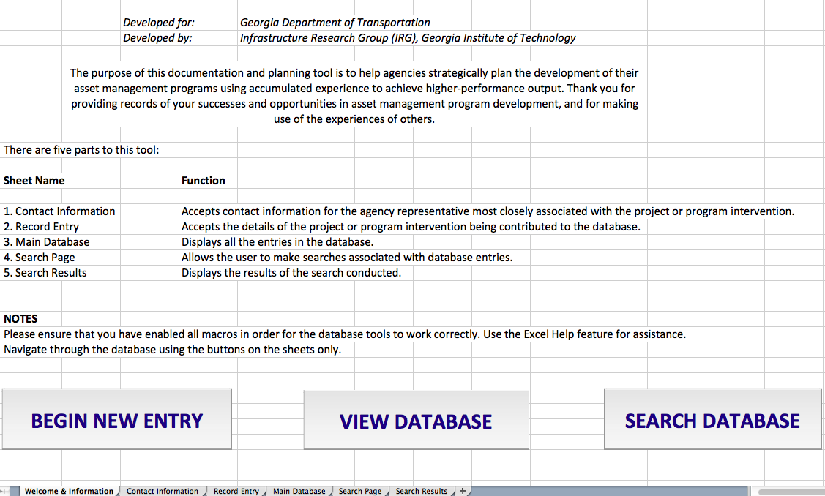
Evidence-Based Database for TAM

Slide 12
Contact Information

Slide 13
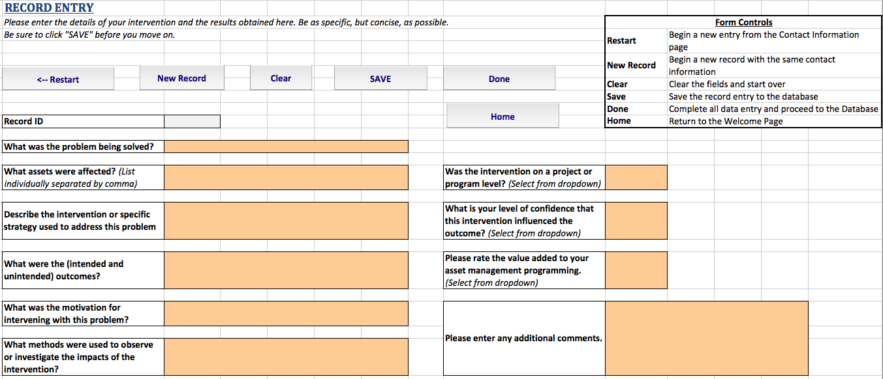
Record Entry

Slide 14
Main Database – Record Details

Slide 15
Main Database – PICMO Details

Slide 16
Evidence Quality
Level of completeness
Percentage of record completeness
Confidence level
Reporting agency’s confidence that the intervention led to a particular outcome
Value added
Amount of value added by the outcome to the agency’s asset management program

Slide 17
Linking Evidence to TAM Maturity

Slide 18
Future Work
Deploy the database on a web-based, more user-friendly platform
Increasing search functionality
Including a contact person repository
Develop the hierarchy to link evidence to TAM
Define quality evidence for EB-TAM
Document additional PICMO case studies
Continue EB-TAM database population
Notes:
1) (e.g. searching all program-level interventions by DOTs)
2) and instead allowing them to pull their name from a stored list
Searching keywords in any part of the record
relieving users from entering their contact information each time

Slide 19
Acknowledgements
The work reported in this study was funded by Georgia Department of Transportation under project RP 12-18: Evidence-Based Applications in Transportation Asset Management. The authors remain exclusively responsible for the information presented in this paper.

